Slide 1
Fundamentals of Electric Grid Transmission Planning
Talk 17: Planning for Electric Grid Resilience including modeling weather impacts
Prof. Tom Overbye
Dept. of Electrical and Computer Engineering
Texas A&M University
overbye@tamu.edu

Slide 2
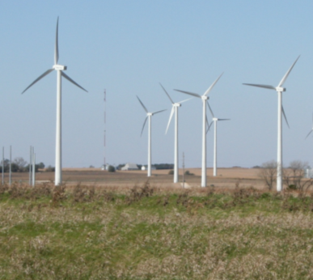
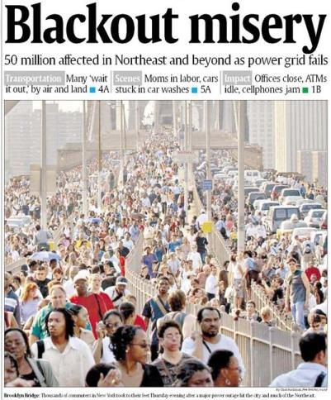
Overview
Our modern society depends on a reliable electric grid with 40% of our energy transported in the form of electricity including most renewables
Blackouts are costly, with some estimates of costs above$100 billion/year in the US.
Growing risk of catastrophic, long-term blackouts
Blackouts cannot be completely eliminated, but risk and impact can be reduced with a more resilient grid

Slide 3
Reliability and Resiliency
Keeping the lights on involves designing and operating the electric grid with a goal of simultaneously increasing two related but ultimately different concepts: reliability and resiliency
Reliability: suitable or fit to be relied on: dependable
One of the key benefits of interconnected electric grids
Resiliency: an ability to recover from or adjust easily to misfortune or change
A key focus of electric grid protection systems almost from day one, but there is a more recent focus on acknowledging that large-scale blackouts cannot be totally prevented, so we must be able to bounce back
2

Slide 4
High-Impact, Low-Frequency Events
In order to enhance electric grid resiliency we need to consider the almost unthinkable events
These include what the North American Electric Reliability Corporation (NERC) calls High-Impact, Low-Frequency Events (HILFs); others call them black sky days, or severe resiliency events (SREs)
Large-scale, potentially long duration blackouts
HILFs identified by NERC were 1) a coordinated cyber, physical or blended attacks, 2) pandemics, 3) geomagnetic disturbances (GMDs), and 4) HEMPs
Image Source: NERC, 2012

Slide 5
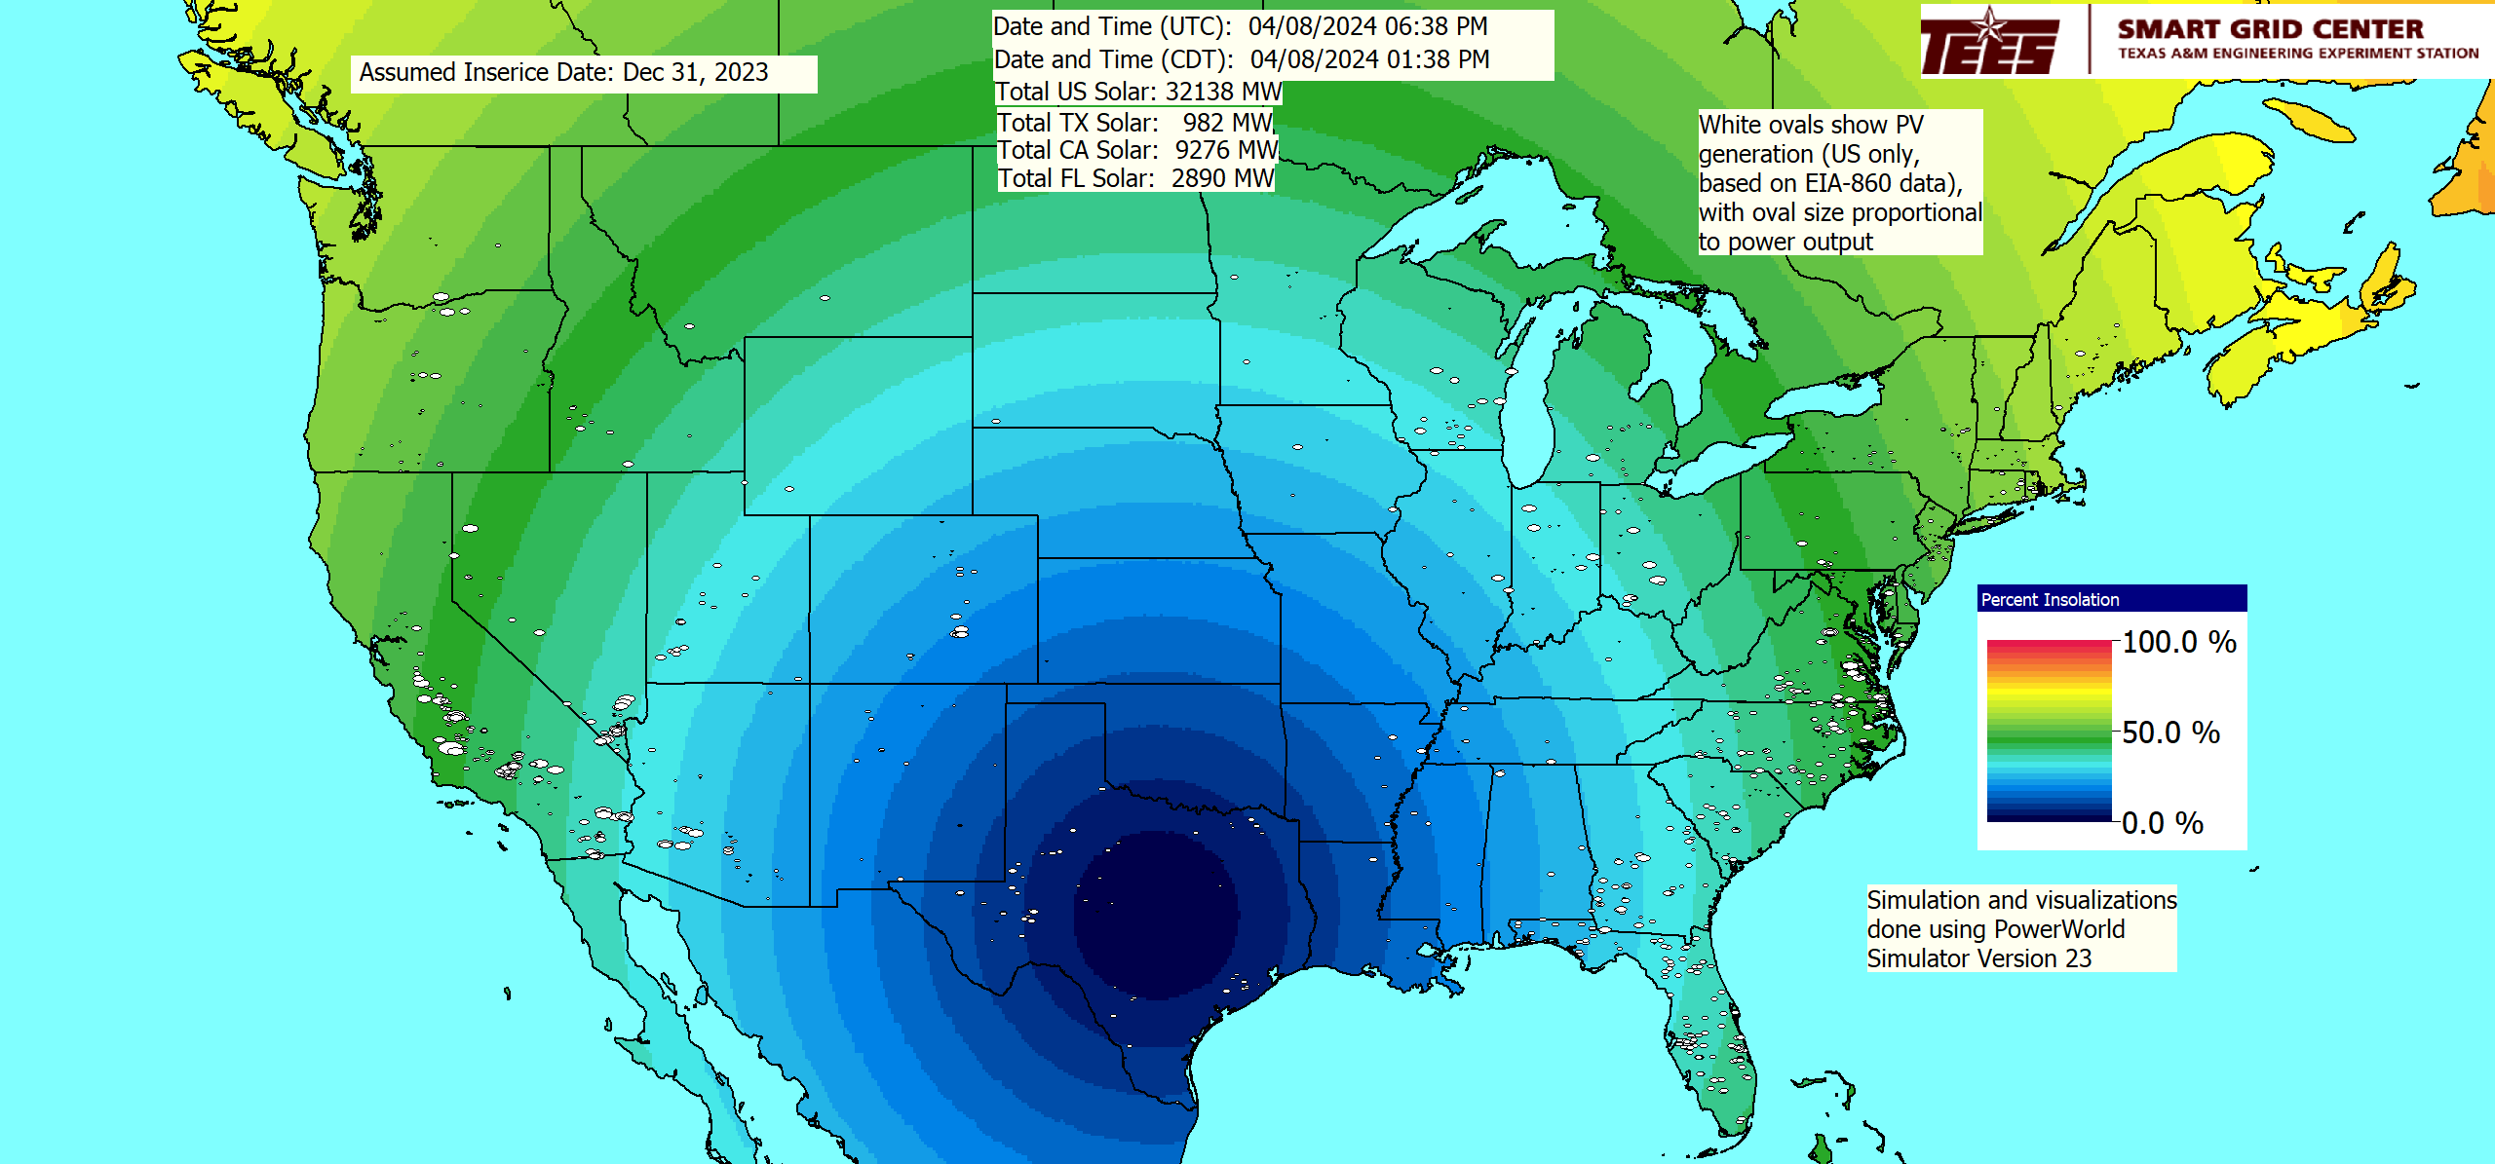
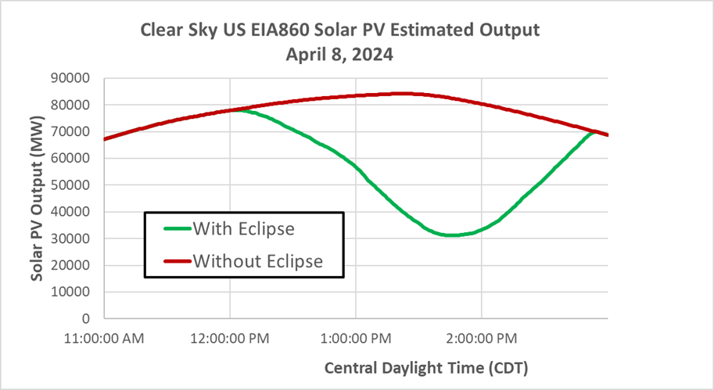
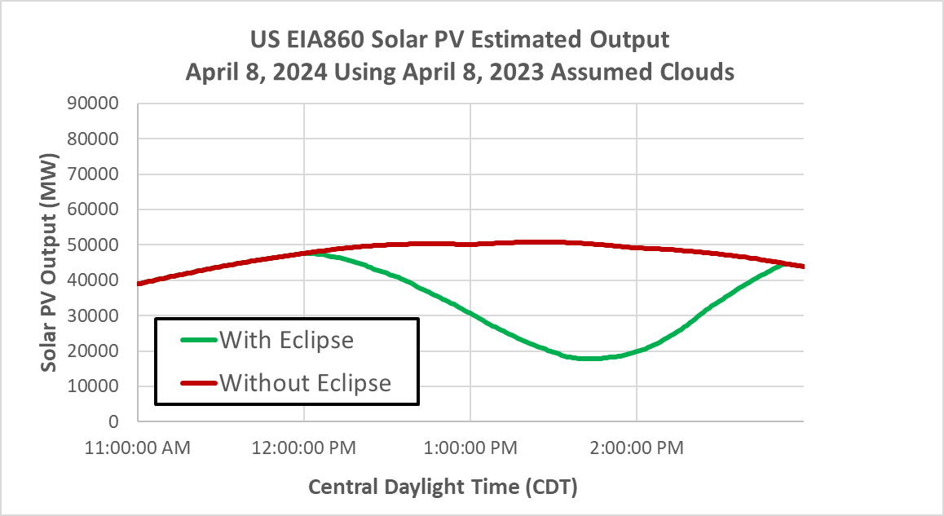
A Benign, Slightly High Impact, Low Frequency Event
There will be a total eclipse on April 8, 2024 that will pass right over Texas; we released a video showing the estimated impact on US PV generation

Slide 6
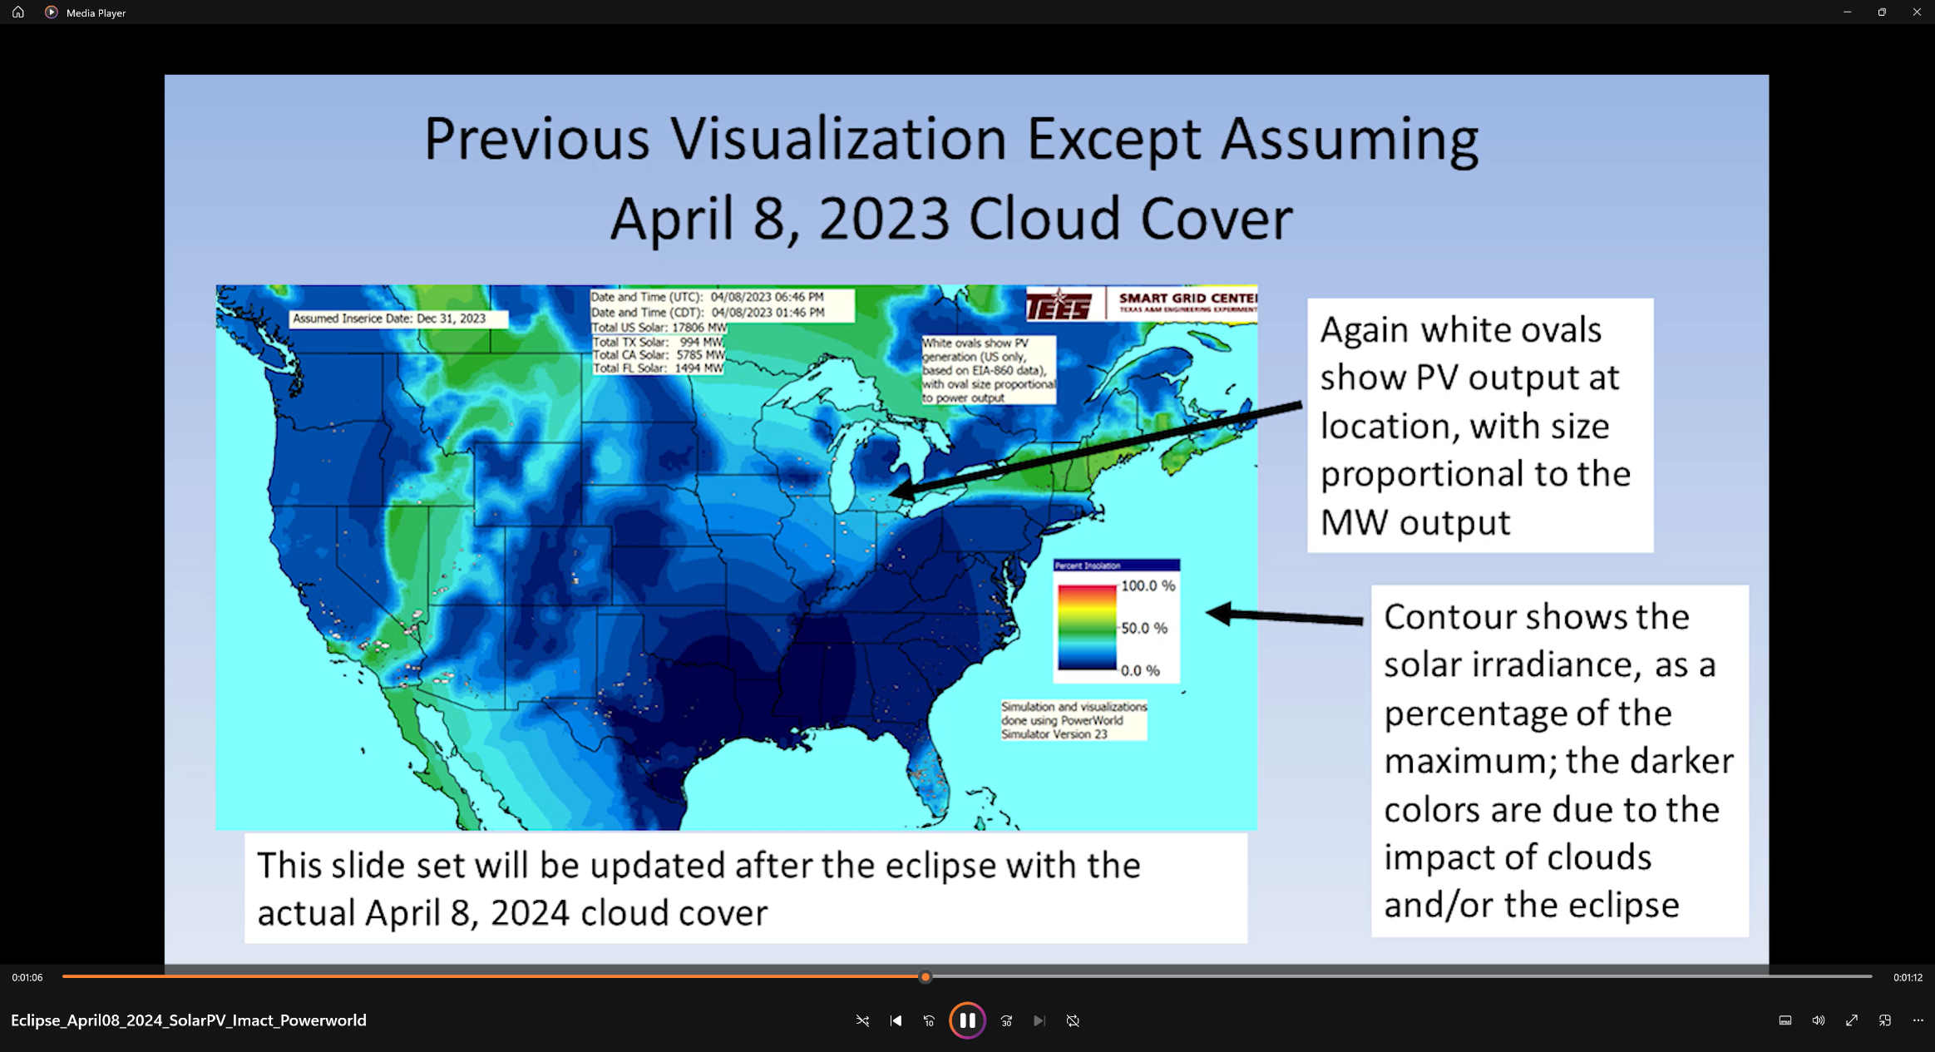
Eclipse Video

Slide 7
What is Grid Resilience?
Merriam Webster Dictionary (resilience in general)
“An ability to recover from or adjust easily to misfortune or change”
EPRI & North American Transmission Forum (NATF)
The ability of the system and its components (… equipment and human …) to minimize damage and improve recovery from non-routine disruptions, including High Impact, Low Frequency (HILF) events, in a reasonable amount of time”
The impact of blackouts is not linear!
Having 100 million people out of service can be more than tens times worse than 10 million out. A ten day blackout can be more than tens times worse than a one day blackout.
These definitions are from the 53rd North American Power Symposium keynote address by Dan Smith of Lower Colorado River Authority, November 2021

Slide 8
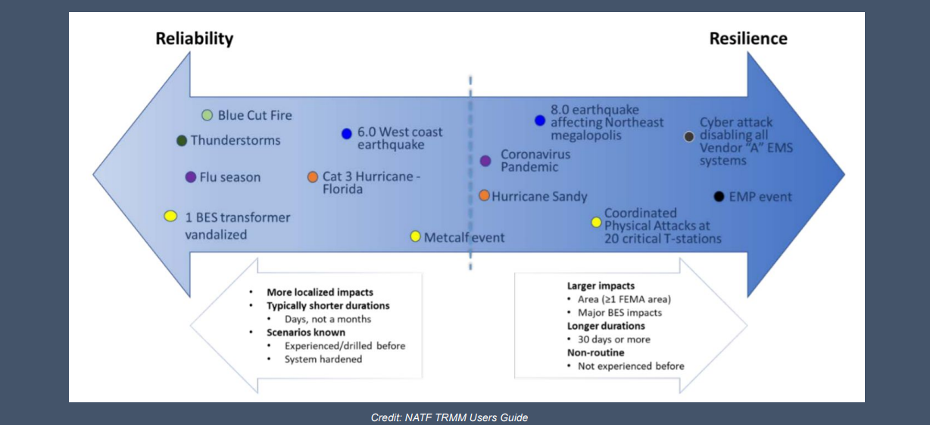
Reliability – Resilience Continuum
Slide is from the 53rd North American Power Symposium keynote address by Dan Smith of Lower Colorado River Authority, November 2021; credit NATF

Slide 9
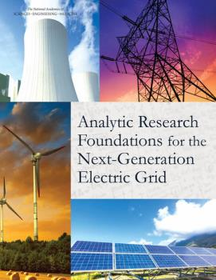
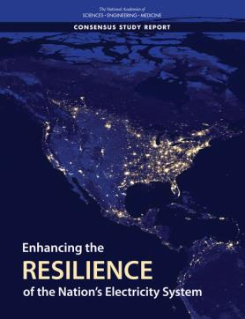
Several Recent Reports on Resiliency
Analytic Research Foundations for the Next-Generation Electric Grid, 2016
Make everything as simple as possible but not simpler [maybe from Einstein]
Enhancing the Resilience of the Nation’s Electricity System, 2017
US Department of Energy Transmission Innovation Symposium, 2021
www.energy.gov/oe/transmission-innovation-symposium
T.J. Overbye, K.R. Davis, A.B. Birchfield, “The Electric Grid and Severe Resiliency Events.” National Academy of Engineering Bridge Journal, vol. 53, no. 2, 2023, pp. 73-79, June 2023.
Focus here is on resiliency

Slide 10
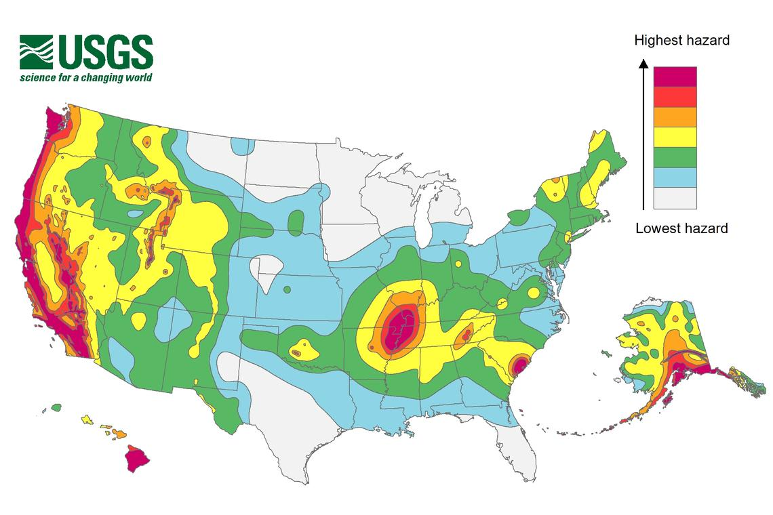
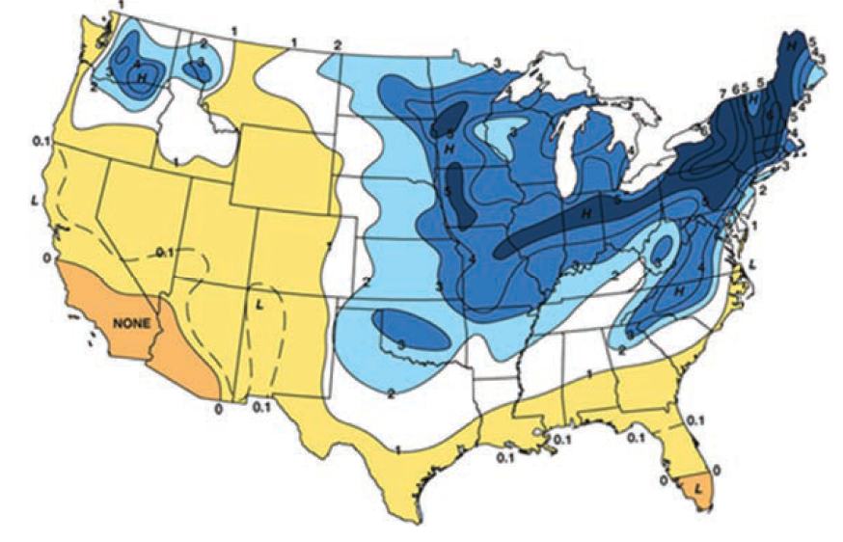
Resilient to What?
A key question on resiliency is to determine the likely threats
Some are geographic, and may are hard to quantify
Earthquake Risk
Freezing Rain Risk
The impact of wind and solar output on the weather is also a growing concern
Source: Enhancing the Resilience of the Nation’s Electricity System, 2017

Slide 11
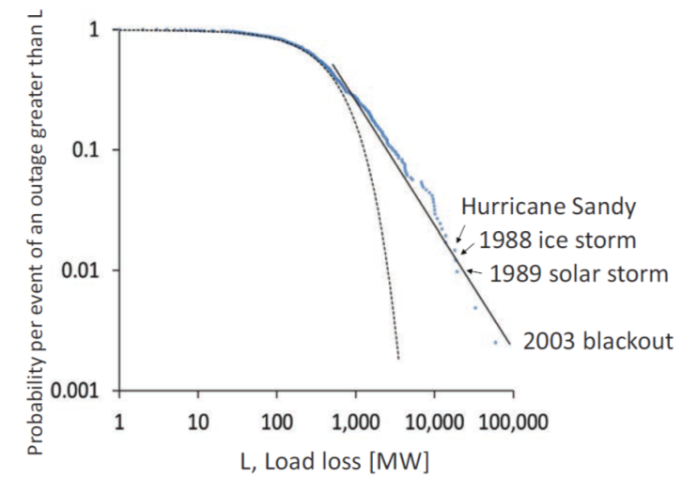
Resilient to What?
Electric grids are complex, and they are subject to a wide variety of different disturbances. Many occur regularly and some have never occurred
The image shows the frequency of US bulk outages from 1984-2015; large events are more common than an exponential distribution would indicate
To consider relative risk, we need to briefly look at probability distributions

Slide 12
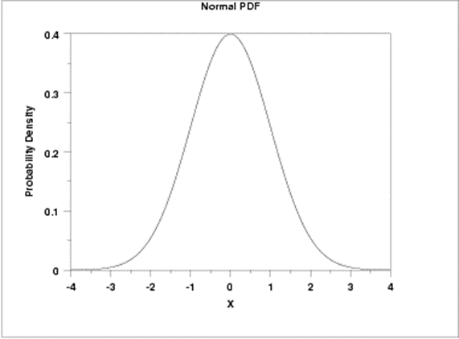
Aside: Probability Distribution Functions
A probability distribution function (pdf) tells the likelihood of an event
Most people are familiar with Gaussian (or normal) pdfs (i.e., the bell shaped curve)
68% within one standard deviation, 99.7 within three

Slide 13
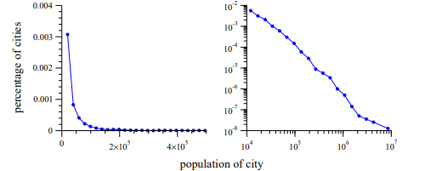
Aside: Power Law Distributions
A power law pdf has a form
This is often known as a Pareto distribution
Many common things seem to follow a power law over a wide range of values. Examples include size of cities, income, earthquakes, blackout sizes
A characteristic of power laws is their scale invariance
City size
City size
The well known 80-20 rule is a power law with an α of 2.16 (e.g., 20% of the people do 80% of the work!)
Image Source: www-personal.umich.edu/~mejn/courses/2006/cmplxsys899/powerlaws.pdf

Slide 14
Aside: Power Law Distributions
Power law distributions have a well defined average only if α is > 2
The first moment of a power law distribution is
For the city example, this tells the number of people in the cities for various sizes
For blackouts it would tell the number of MWs lost by the various sized outages
For α ≤ 2 this value is undefined, meaning the tail [rare events] dominates (for cities it is estimated to be about 2.3)

Slide 15
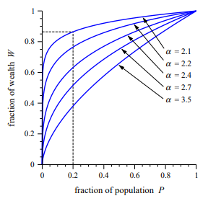
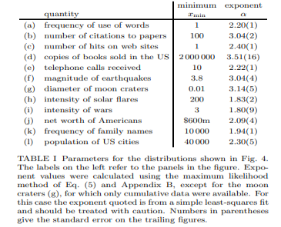
Aside: Power Law Distributions
When considering a phenomena, it is useful to known 1) does it follow a power law, 2) if so over what range, and 3) what is it’s α exponent
Images Source: www-personal.umich.edu/~mejn/courses/2006/cmplxsys899/powerlaws.pdf

Slide 16
Power Law Application to Grid Resiliency
Blackouts have been shown to have a power law distribution, with an α of close to the critical value of 2
This provides justification for devoting a substantial amount of resources to minimizing the likelihood of large events
Grid resiliency needs to consider rare events, but some of these events have power law distributions
Geomagnetic disturbance size, earthquakes
However, some do not (EMPs, physical and/or cyber attacks)
Wind and solar resource droughts?

Slide 17
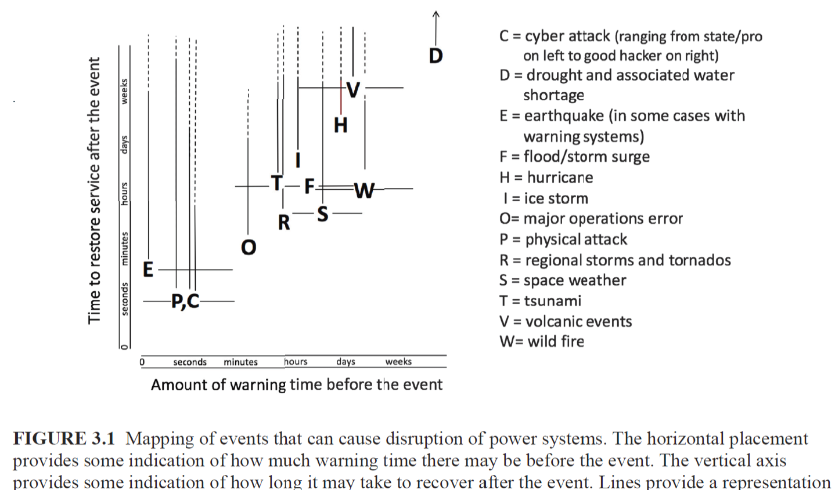
Some Electric Grid Risks
Source: Enhancing the Resilience of the Nation’s Electricity System, 2017

Slide 18
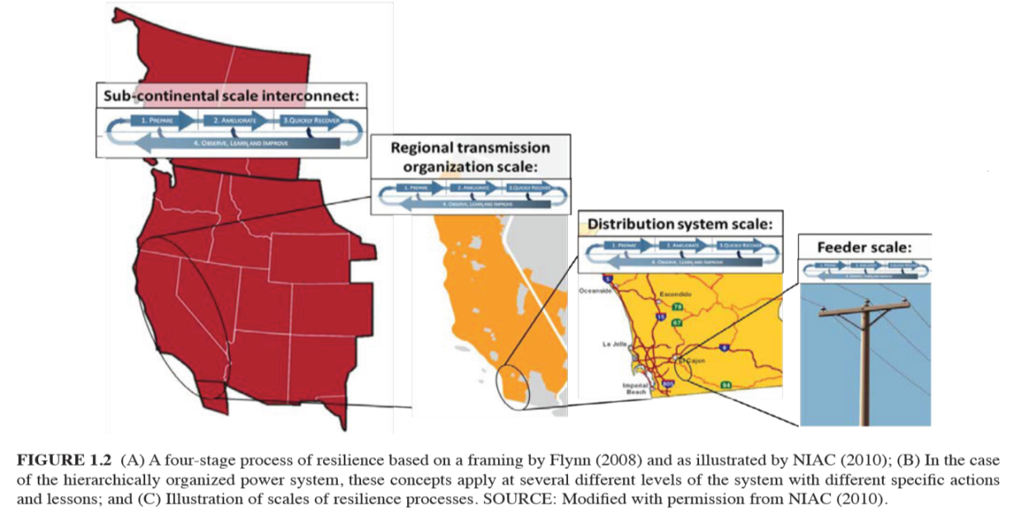
Resilient Event Size
Grid resilience events can range from continental down to local
Most, but not all, events would likely be contained within a single electrical interconnect
Image Source: Figure 1.2, NAP 2017

Slide 19
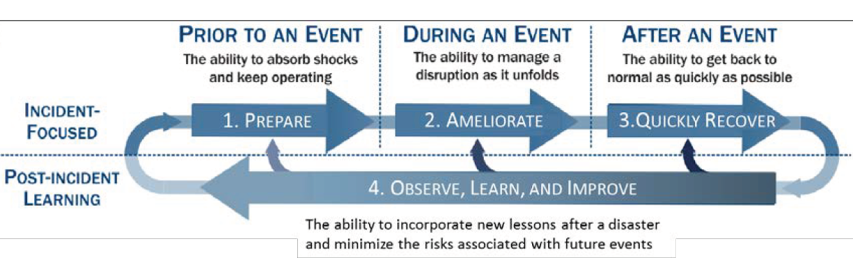
Major Considerations with Resiliency
Understanding, and ultimately enhancing resiliency, requires consideration during three periods
Prior to an event
During an event
After an event
All three require planning ahead of time and flexibility as events unfold
This is presented as Figure 1.2a in the National Academies’ Enhancing the Resilience of the Nation’s Electricity System report (2017), and is originally from
S.E. Flynn, “America the resilient: Defying terrorism and mitigating
natural disasters.” Foreign Affairs, vol. 87: 2–8 (2008) and as illustrated by the National Infrastructure Advisory Council (NIAC) in 2010.

Slide 20
How to Approach HILF Events
The goal in studying HILFs is seldom to replicate a specific event
Many have not occurred, and within each class there can be great variability (e.g., a physical attack)
Nor is it to ensure there is no loss of service
Rather, it is to be broadly prepared, and to be able to do at least a reasonable cost/benefit analysis
HILF simulations can help in preparing for the unexpected
Several techniques, such as improved control room rare event situational awareness and better black start procedures, are generally applicable

Slide 21
Challenges
An all hazards approach to considering resiliency is crucial, but there is no a “one-size-fits-all” solution
Identifying particular strategies to improve resiliency, to at least some degree, is relatively easy
The challenge is developing appropriate priorities for actions, and determining the appropriate political and organizational support to make it happen
Just expecting electric utilities to make the investments necessary, while many are losing customer revenue to self-generation, might not be realistic
HILFs (or perhaps Severe Resiliency Events [SREs] is better) come in a continuum of frequencies and impacts

Slide 22
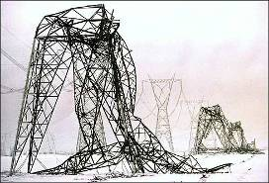
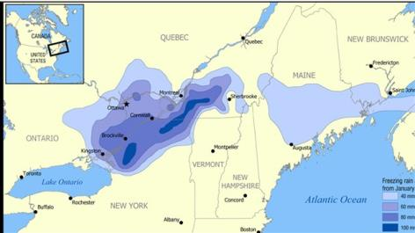
Examples of Larger-Scale or Long Duration Outages
Quebec geomagnetic disturbance blackout of 1989
Auckland, NZ 1998 five week blackout due to cable failures
Northeast ice storm of 1998: A week long ice storm that resulted in more than three inches of ice on high voltage transmission lines, causing the collapse of 770 transmission towers and the replacement of 26,000 distribution poles

Slide 23
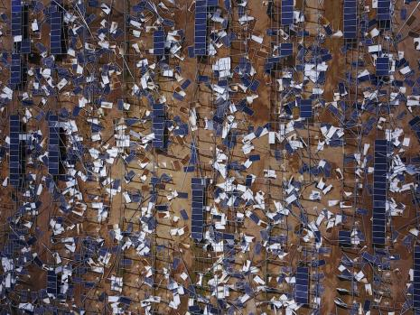
Examples of Larger-Scale or Long Duration Outages, cont.
Northeast blackout from August 14, 2003 (we’ll cover this one in detail later)
Hurricane Katrina (2005) with loss of service to 2.7 million customers, with 250,000 still out after 4 weeks
Superstorm Sandy (2012) with more than 8 million customers out, and about 10% still out after ten days
Cyber attack on Ukrainian Electric Grid (2015)
Hurricane Maria (2017) in Puerto Rico, with essentially a total loss of the grid
Image Source: IEEE Spectrum, P. Fairley, “Why Solar Microgrids May Fall Short in Replacing the Caribbean’s Devastated Power Systems”, October 2017

Slide 24
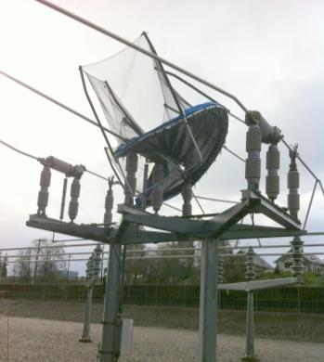
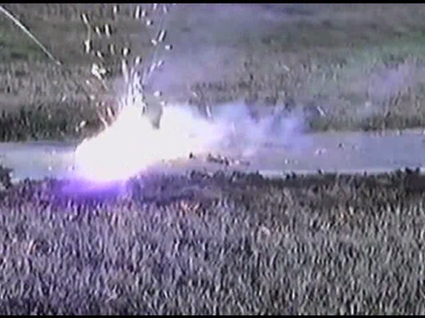
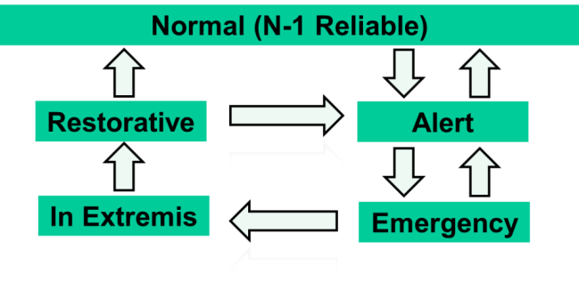
The Grid Needs to Be Resilient to Lots of Disturbances on Different Time Frames
Events short and long-term
Lightning strikes can usually be cleared within seconds
But ice, tornados and hurricanes can bring large-scale damage over long timer periods
Need to consider all operating conditions
Image Derived From L.H. Fink and K. Carlsen, “Operating under stress and strain,” IEEE Spectrum, March 1978, pp. 48-53
Images from T. Rolstad and B.D Russell

Slide 25
HILF Two Main Categories
HILF events can be divided into two broad categories: 1) those not caused by human agents, and 2) those caused by human agents
Modeling the non-human events is somewhat easier because the goal is to (at least generally) replicate what has occurred, or what could occur
With human agent events the challenge is to protect the grid from potential events, without exposing vulnerabilities to an adversary or giving out potential mechanisms of attack
Synthetic grids are good for both

Slide 26
Resilience and Grid Size
There is no optimal ac grid size for resiliency
Larger grids can share resources, particularly during emergencies, and can provide access to larger power markets
But larger grids also open up the risk to cascading outages, potentially causing large scale blacks
The world’s largest grids are 1) State Grid of China (900 GW), 2) Continental Europe (850 GW), 3) North American Eastern Interconnect (650 GW)
Probably the most effective approach is to have grids the can flexibly breakup into smaller grids (known as adaptive islanding

Slide 27
General Grid Resilience Comments
Understanding resilience requires considering how grids will respond to particular disturbances
Substantially changing the topologies of existing grids is usually not an option
Simplistic studies of how a grid disturbance could cascade often lead to incorrect conclusions
Sequential power flows, sequentially taking out overloaded devices are not particularly helpful
Full detail models of large-scale actual grids including the protection system usually don’t exist and modeling them would requiring knowing the associated remedial action schemes

Slide 28
Economic Valuation of Resilience
While certainly challenging, metrics are needed to help determine the value of resilience to society
If we need to improve resiliency, someone needs to pay
This is becoming a more challenging problem as more customers provide self-generation
Is the ability of some customers to self generate, at least for a period of time, a net gain to the grid’s resiliency? How does one assess the resiliency of their systems?
Given that both reliability and resilience are often desired, their needs to be a co-optimization of their benefits.

Slide 29
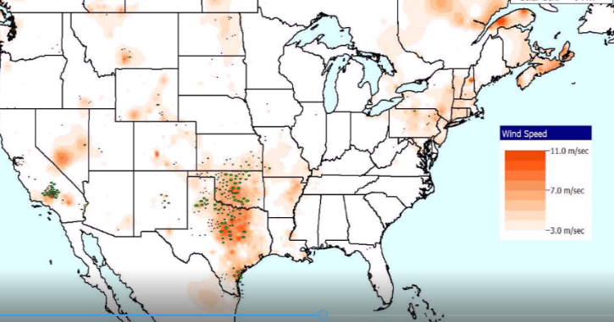
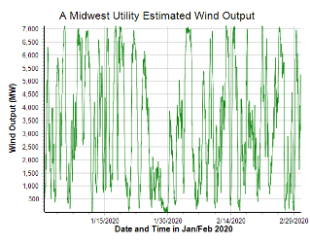
SRE Example: Renewable Resource Droughts
With the rapid growth in wind and solar resources, a growing concern is how to handle wind and solar “droughts” with the generic term of renewable resource droughts used to describe them
The below example is a wind drought that occurred in the Midwest in late January 2020

Slide 30
Weather in Electric Grid Planning and Operations
Weather information has been used in electric grid planning and operations going back to the initial grids in the 1880’s
In operations real-time weather information has been long used in control rooms, with computerized information used at least since the 1980’s; current applications are quite sophisticated
In planning weather information plays many roles, including load forecasting, outage scheduling and in the development of planning power flow cases (summer, winter, spring, fall)
The next few slides show some new developments in using weather (and related external resiliency events) in the planning (and related applications)

Slide 31
The Power Flow and Weather
Human activity depends on the weather, and this has always been reflected in the electric load
Traditionally some power flow parameters have depended on the weather (e.g., line ratings, turbine max MW, line resistance)
Over the last several decades this dependence has grown substantially with the increase in wind and solar generation
They now provide about 17% of US electric energy (> 30% in ERCOT); there are times when most of the electricity in regions is supplied by these sources
They are extremely dependent on the weather
Major power system input parameters are now heavily weather dependent (e.g., wind and solar generator Max MW)

Slide 32
Using Weather with Planning with Simulator
Over the last 18 months PowerWorld has gained a lot of weather modeling related capability, and is continuing to gain more
Currently
Past, present and future weather data can be loaded into Simulator
This can be done using *.pww, *.aux, or *.csv files
Hourly past data is available from 1940 to five days behind real time; present data is available from measurements; future is hourly up to 16 days
The weather can impact the power system devices using PFW (Power Flow Weather or Power Flow Whatever) models; PFW models can be thought of like the stability models: they are applied to power system objects (e.g., a generator or line) and different classes of models can be defined
PFW models can be applied automatically in the Time Step Simulation, and applied (currently) on demand in the other applications like power flow

Slide 33
Availability of Historical Weather Information
When this effort started we were using historical weather station measurements (mostly identified by their ICAOs [International Civil Aviation Organization], e.g. KLIT, KCLL)
We had lots of data, but much of it had missing values; we also only had surface wind values and no direct solar measurements
Such measurements at specific locations are very useful (e.g., at electrical substations)
We are also now using ERA5 data, which is state-of-the art (fifth generation) reanalysis of global climate and weather since 1940
It is available hourly on a 0.25 degree grid and includes 10m and 100m wind, and solar global horizontal irradiance and direct horizontal irradiance
ERA5 comes from European Centre for Medium-Range Weather Forecasts (ECMWF), (ERA = ECMWF Re-Analysis) with more details on ERA5 available at rmets.onlinelibrary.wiley.com/doi/10.1002/qj.3803

Slide 34
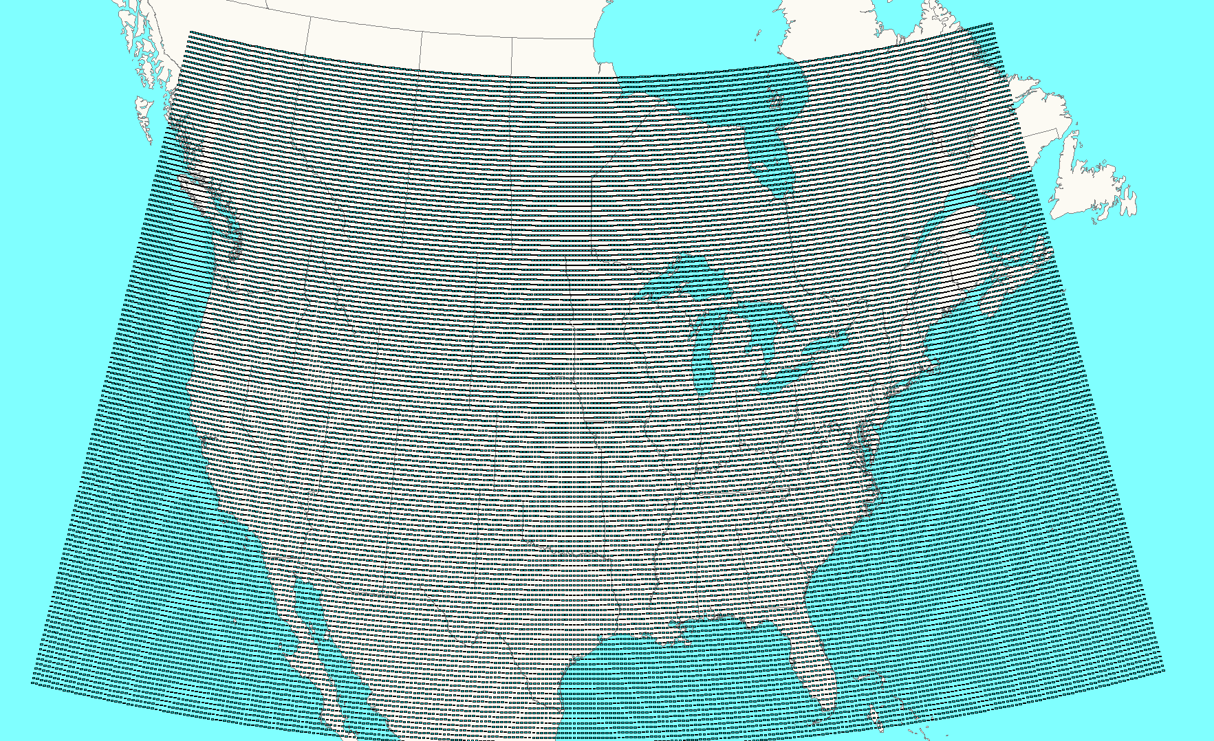
Easy Power Flow Access to ERA5
ERA5 is available worldwide about five days behind real-time
We convert it to pww format files, and place it at electricgrids.engr.tamu.edu/weather-data/
Currently we provided data for most of North America and then smaller files for just Texas
For each hour the pww files store eight weather values (temperature, dew point, cloud cover percent, wind speed (10m), wind direction (10m), wind speed (100m), global horizontal irradiance, and direct horizontal irradiance
The North America pww files have 38,497 data points; with 8 values per hour, this is about 220 MB per month, or about 225 GB for the total set
This data is public so it can be freely used and shared

Slide 35
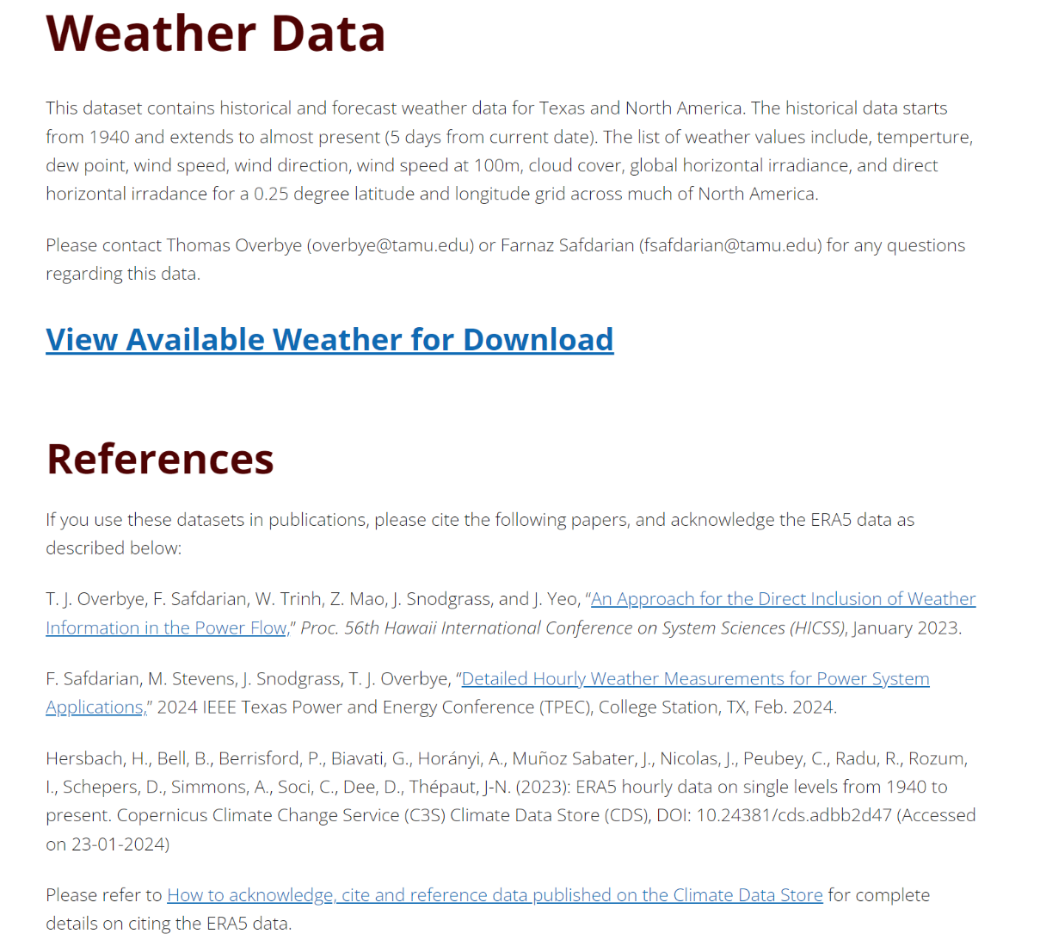
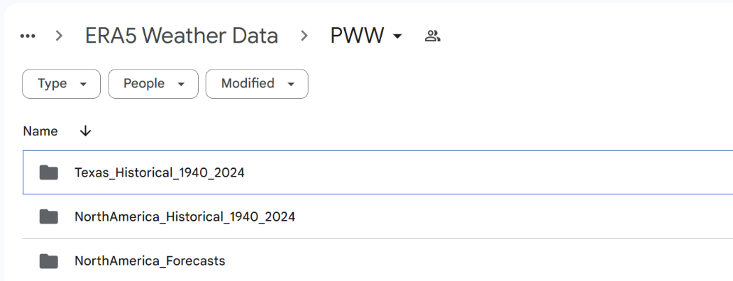
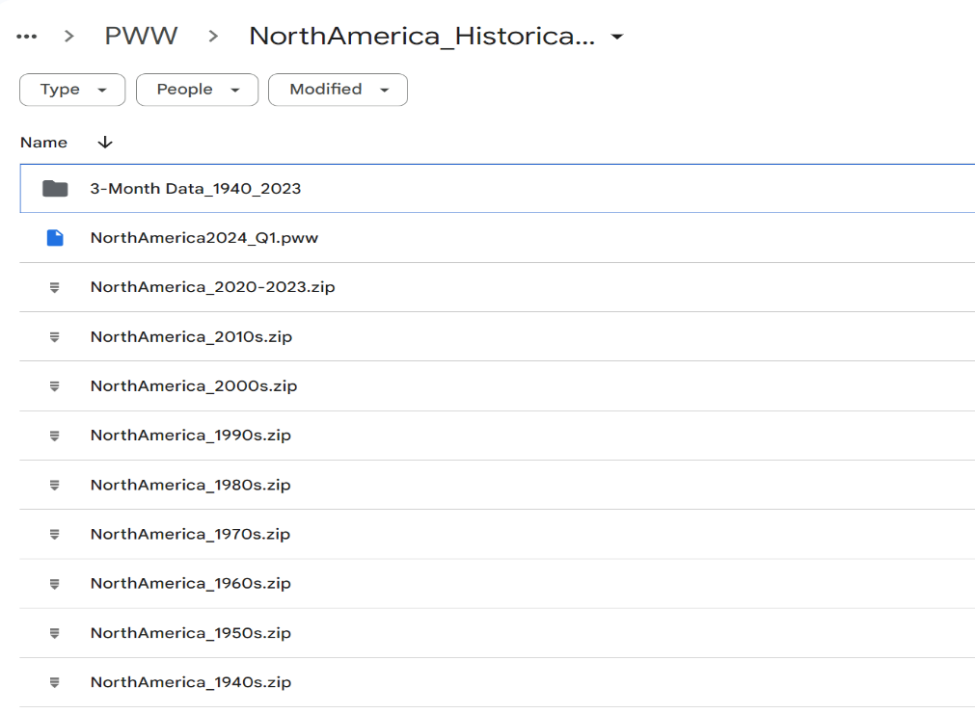
Eelectricgrids.engr.tamu.edu/weather-data/
Only get 3-month data is your download speed is slow
Data for current year, updated daily
Historical data; that is, a onetime download; getting a decade took me about 4 minutes

Slide 36
Hands-On: Visualizing and Using Weather
Example North America weather for the first part of 2024, and a recent forecast, have been including in the Talk_17 directory
First demonstration shows the use of weather without a power grid
Open any case (e.g., the 37 bus case in the Talk_17 directory)
Go to Tools, Weather, Weather Models and Information; go to the Weather Stations page; in the Load Historical Weather from *.pww Files click on Browse to change the weather directory to the Talk_17 directory
Enter a date and time between 1/1/2024 and 3/10/24, then click Just Get Weather for Desired Date
This loads the data; if desired it can be easily contoured using one of the displays in the directory

Slide 37
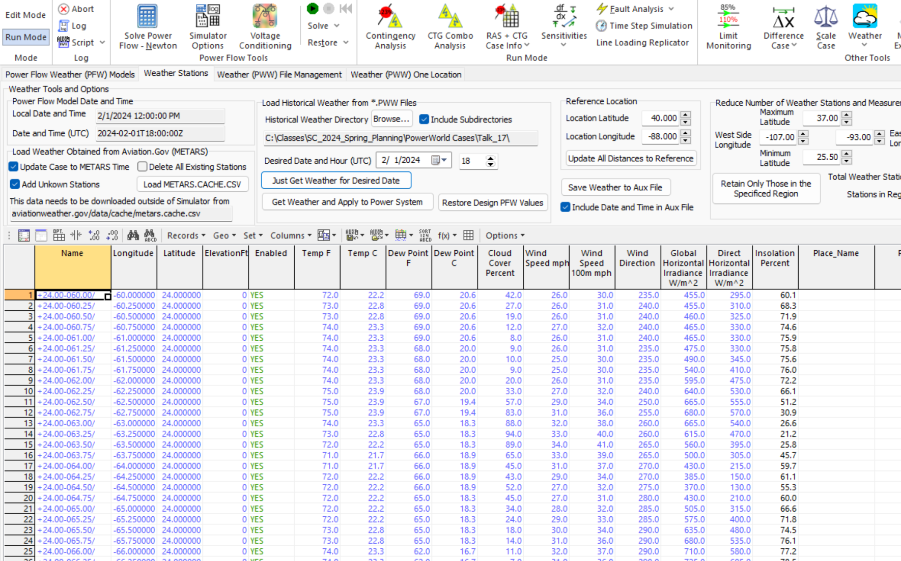
Viewing Weather for an Hour (Using Talk_17 data)
Goto Tools, Weather, Weather Models and Information, Weather Stations Page to view the weather for any valid time
Directory for pww files
Enter the day and hour; note, all times are Coordinated Universal Time (UTC)
Click Just Get Weather for Desired Date to get the weather; it takes about a second

Slide 38
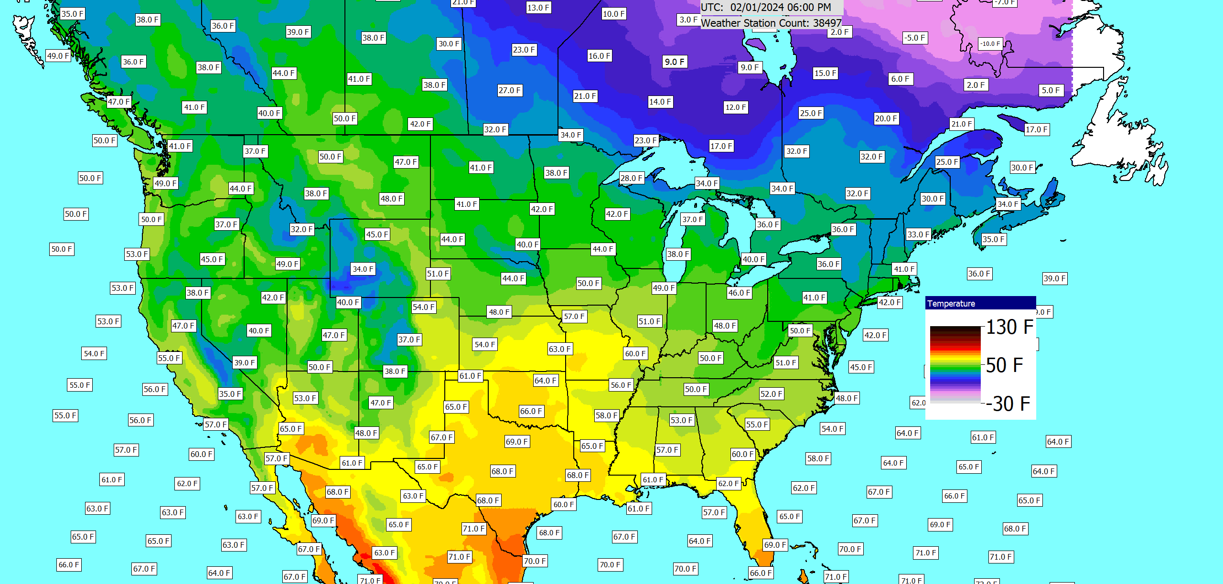
Example Weather Contour
The contour labels can easily be customized or removed

Slide 39
Available ERA5 Historical Fields in PowerWorld
The ERA5 dataset has hundreds of different values; currently we are using eight of them
Surface temperature, surface dew point
Wind speed at 10m, wind direction at 10m
Wind speed at 100m
Total cloud cover (which takes into account all the layers)
Total sky direct short-wave (solar) radiation at surface (fdir); used to get the direct horizontal irradiance and the Direct Normal Irradiance (DNI)
Surface short-wave (solar) radiation downwards (ssrd); this is used with the direct horizontal irradiance to get the Diffuse Horizontal Irradiance
Derived values like humidity are also available
Other values could be used, like 10m wind gusts and icing estimates

Slide 40
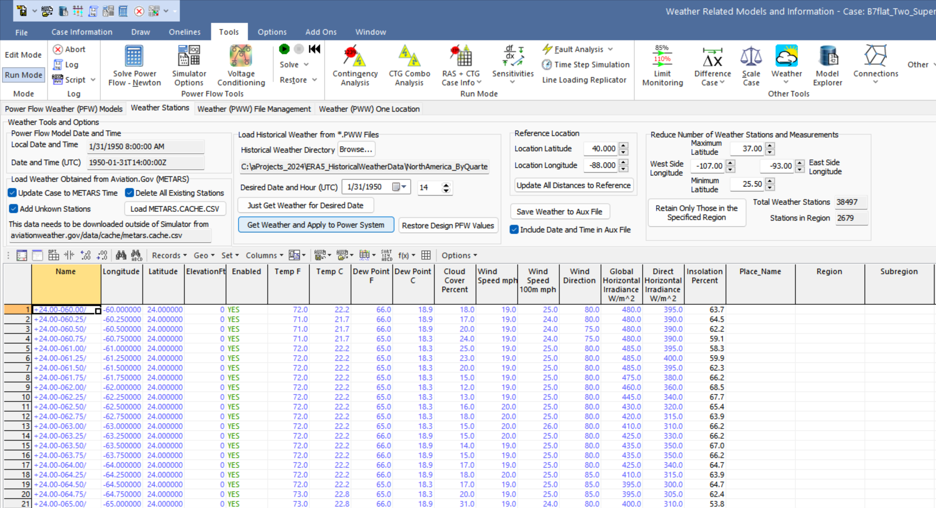
Saving Snapshot Weather in an Aux File
Weather for a particular hour can be easily saved in an aux file

Slide 41
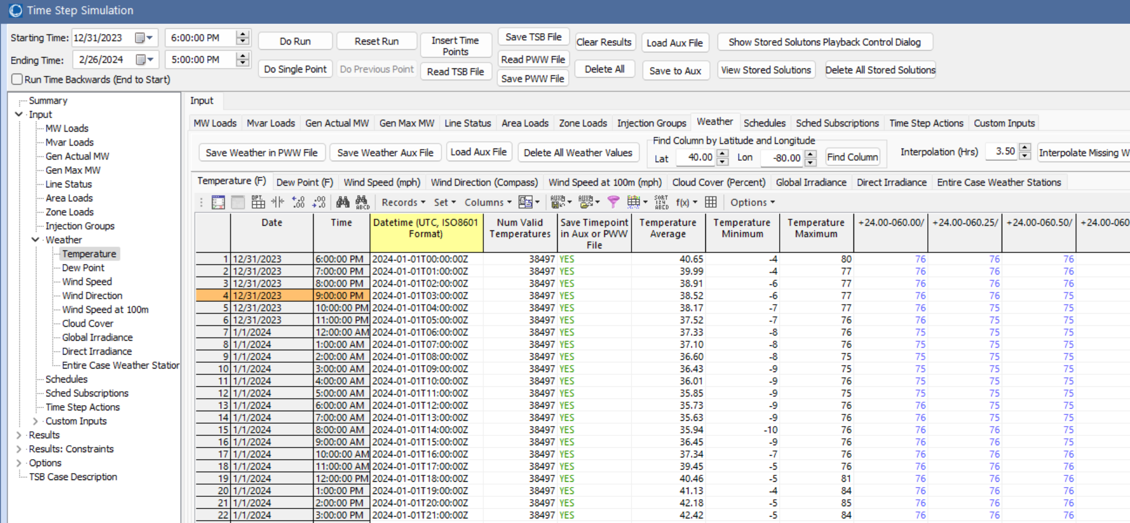
Simulating Large Amounts of Weather Information
To easily view and simulate many time values, the pww files can be loaded into the Time Step simulation (Tools, Time Step Simulation)
Select Read PWW File to load the desired file
Allows a weather location to be easily located (Seattle here)
Like any PowerWorld case information grid, the data can be easily plotted and exported

Slide 42
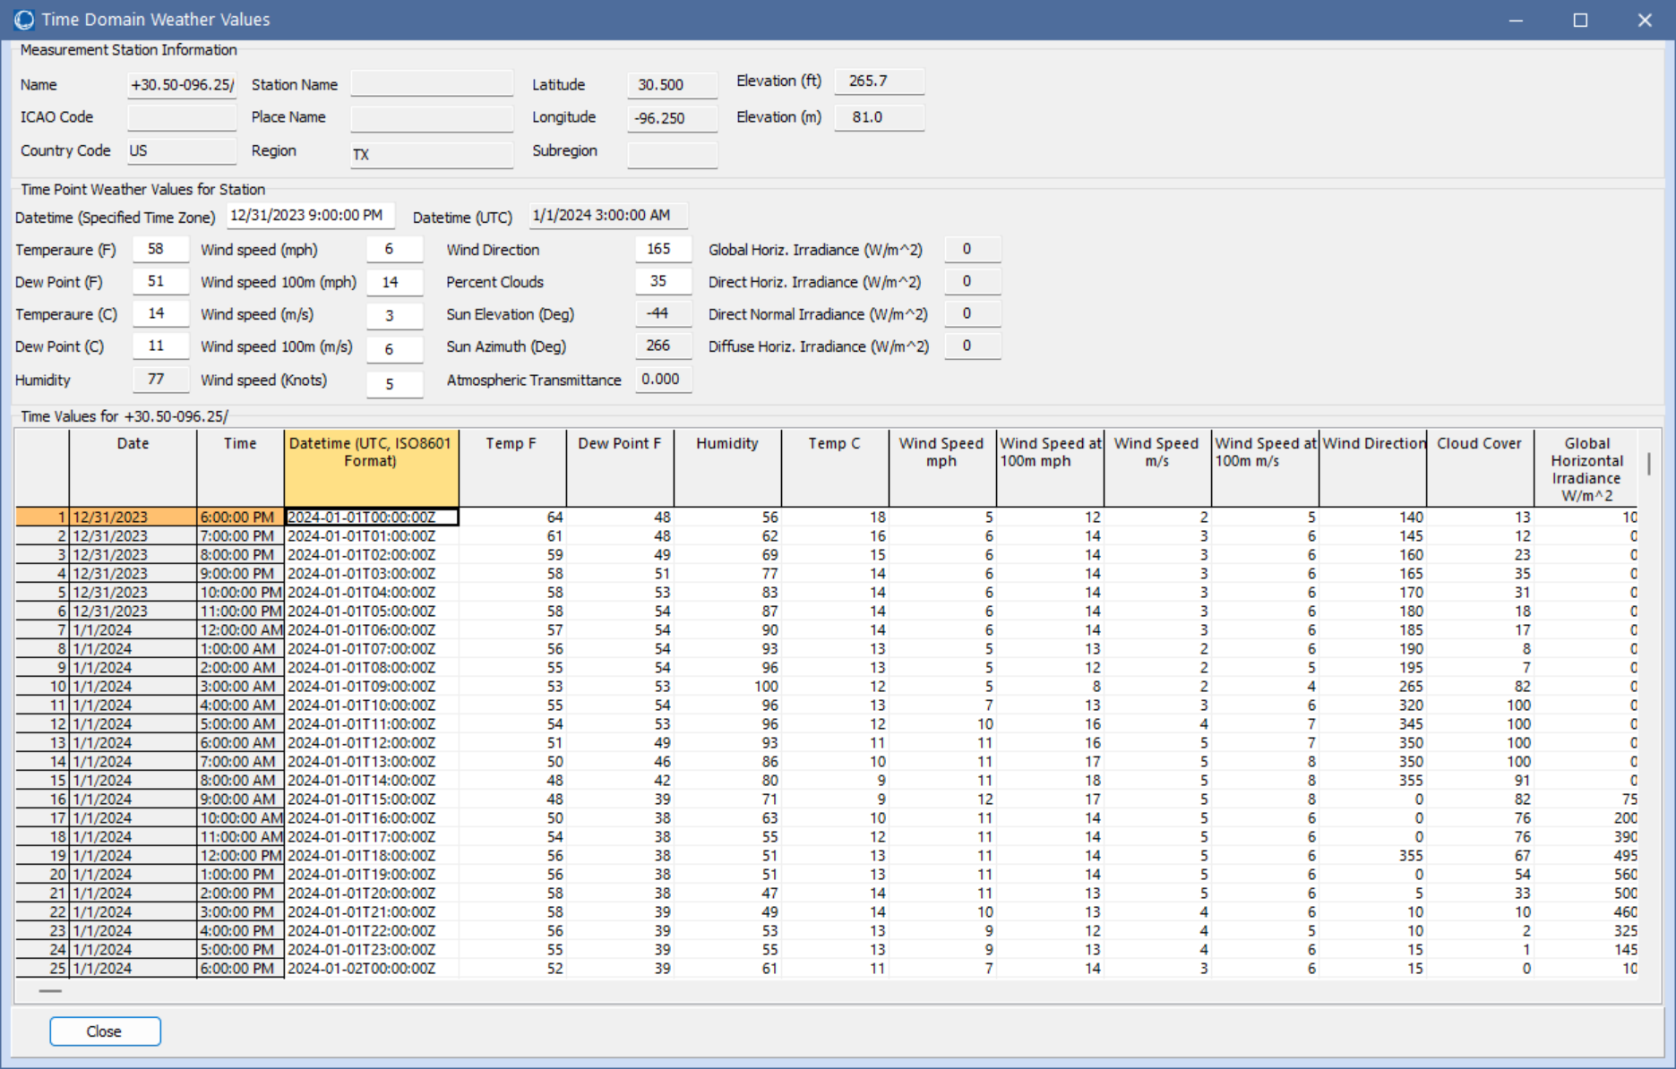
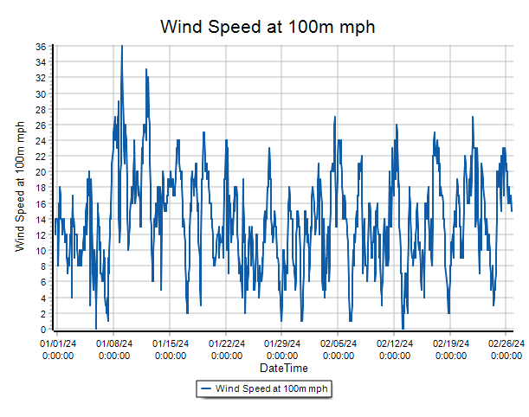
Seeing All Weather Data for a Location
To see all the weather data for a location, just right-click on the column and select Show Dialog
College Station 100m Wind Speed

Slide 43
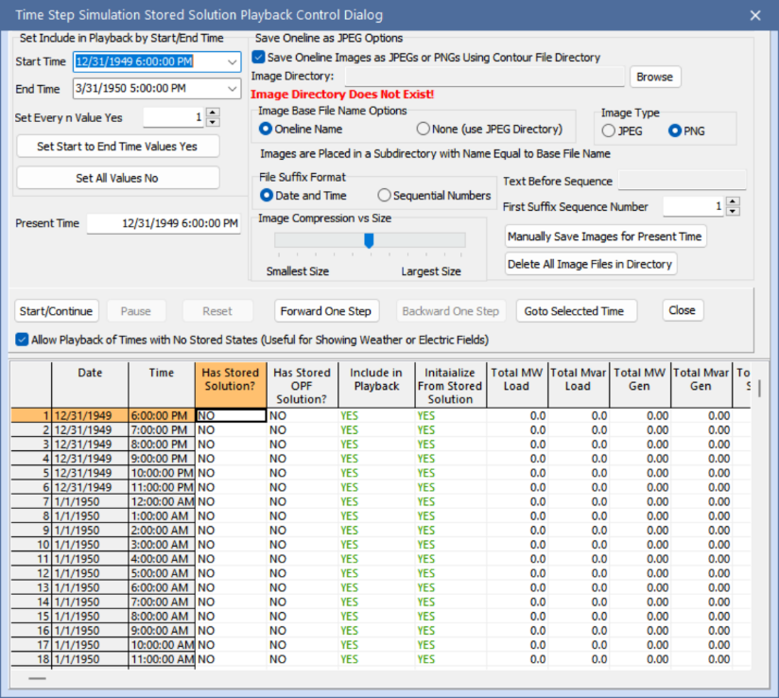
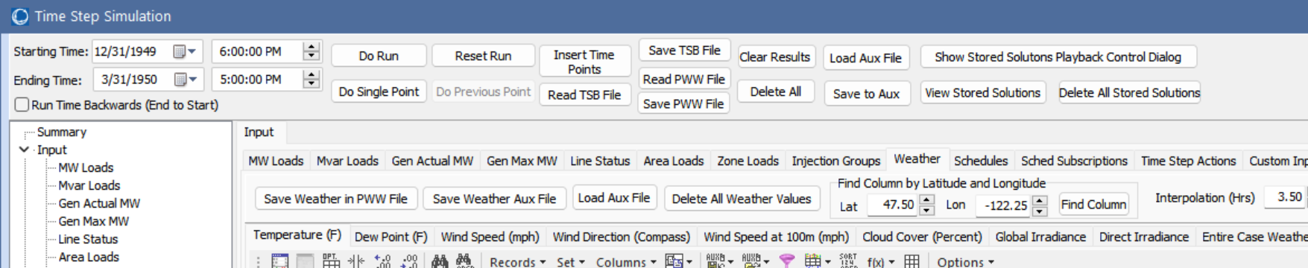
Visualizing Time-Varying Data
In addition to graphs, in the Time Step Simulation the data for any time point can be easily visualized by right-clicking on the desired time and selecting Time Point Records, Apply Time Point (with Weather Update)
Movies can be easily created by using the Stored Solutions Playback Control Dialog to create a series of jpg or png files, then using image software like Adobe Premiere Pro

Slide 44
Availability of Forecasted Weather Information
Forecasted weather information is also available from a variety of sources; here we use the free forecasts provided by US National Oceanic and Atmospheric Administration (NOAA) National Centers for Environmental Prediction (NCEP) NCEP Central Operations
nco.ncep.noaa.gov/pmb/products/gfs/
Specifically we’re using the 0.25 degree resolution GFS results, which provide four global forecasts per day going out for 16 days (hourly for the first five days, then every three hours)
Forecasts are also pww files, so all of the existing tools can be used, though the forecasts to not have the solar irradiance values
File names include the run time in ISO 8601 format. Example is “Forecast_NorthAmerica_Run2024-02-07T06Z.pww”
The date tells when the forecast was run; they contain 16 days

Slide 45
Models of Grid Weather Impacts
Key focus here isn’t weather per se, but modeling the impacts of weather on electric grid components (e.g., generators, lines)
Certainly a number of models already exist, and undoubtedly more will be created given that weather data is now conveniently available
The approach used here for handling a growing list of models is to mimic what has been done with power system stability – start small and expand
Early (1960) stability codes just had a handful of models, whereas current codes support many hundreds of different model types
PowerWorld implements this using PFW Models
PFW = Power Flow Weather or Power Flow Whatever models

Slide 46
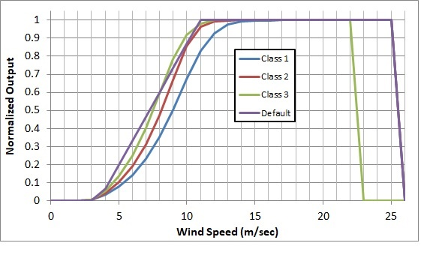
Example: Gen MaxMW Wind and Solar
An example is modeling the impact of wind speed on wind turbine output, or solar irradiation on PV output
The image on the right shows several of the generic wind turbine models are based on the turbine classes using data from [a]
A simple solar PV model uses either provided solar irradiation or the standard equations for insolation based on location and time of day including cloud cover; this is combined with whether the solar has tracking and, if needed, its tilt and azimuth
[a] C. Draxl, A. Clifton, B. Hodge, J. McCaa, “The Wind Integration National Dataset (WIND) Toolkit,” Applied Energy, vol. 151, pp. 355-366, 2015.

Slide 47
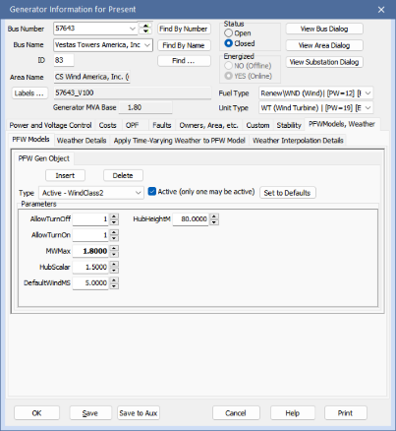
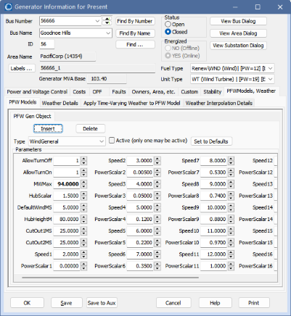
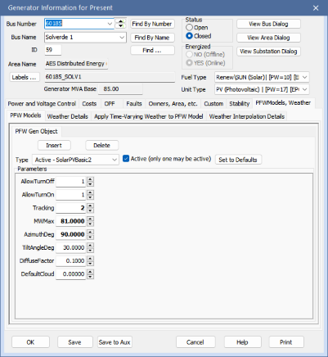
Example: Gen MaxMW PFW Model
Individual generator PFW models can be entered or viewed using the generator dialog

Slide 48
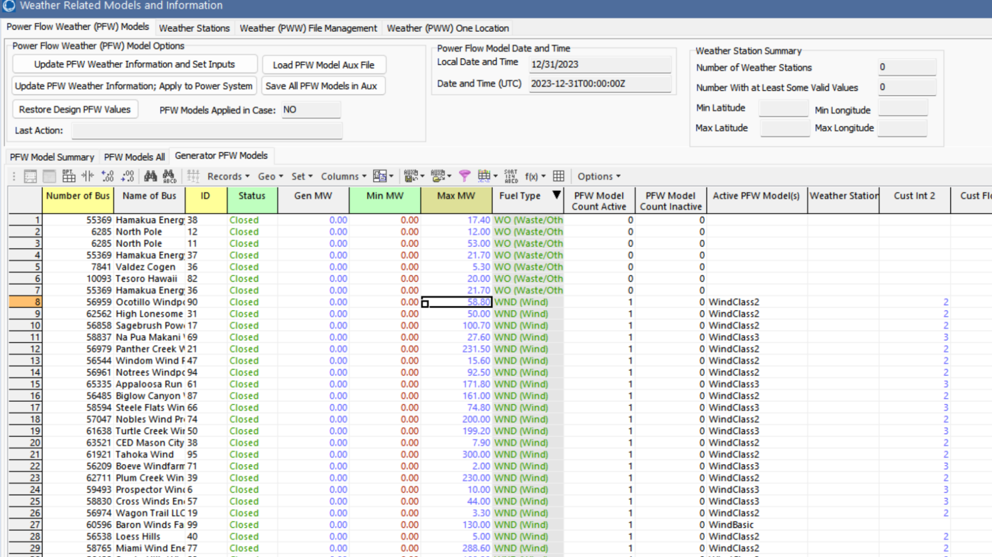
Entering Large Number of PFW Models
A large number of PFW models can be entered by going to the Weather, Weather Models and Information, PFW Models page
The Generator PFW Models list shows all the generators in the case
Select the desired ones, right-click and select Insert New PFW Models

Slide 49
Making it Easy to Get Started: Using EIA-860 Data
To make it easy to get started we’ve setup copper plate (i.e., no transmission) power flow cases with PFW models based the data provided by the US Energy Information Administration (EIA) in their Form EIA-860 datasets
EIA-860 provides data on every generator in the US with 1 MW or more capacity
Available at www.eia.gov/electricity/data/eia860/; it is released yearly with monthly updates available
We take this data and convert it into a copper plate power flow model, with the resultant cases publicly available at
electricgrids.engr.tamu.edu/eia-860-generator-data-cases/
Details on this process are in a 2024 TPEC paper (available as 2024 paper 3 at overbye.engr.tamu.edu/publications/)

Slide 50
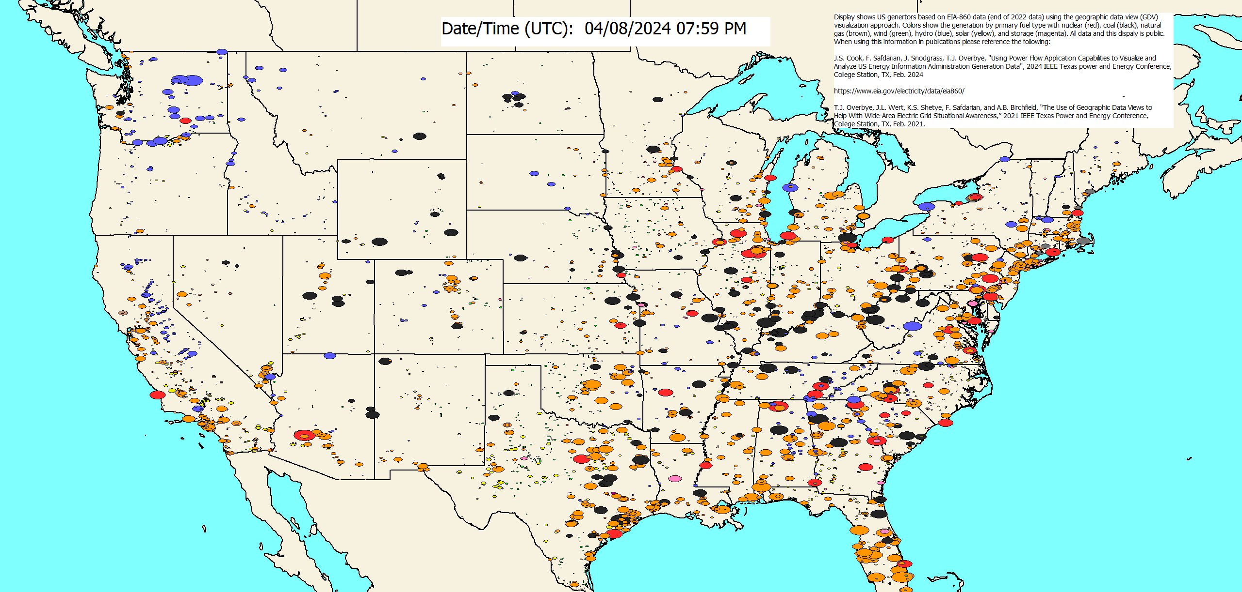
Example: Open Case EIA-860_Latest_2023Q4

Slide 51
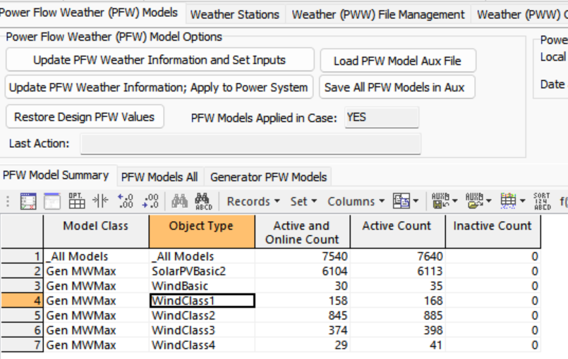
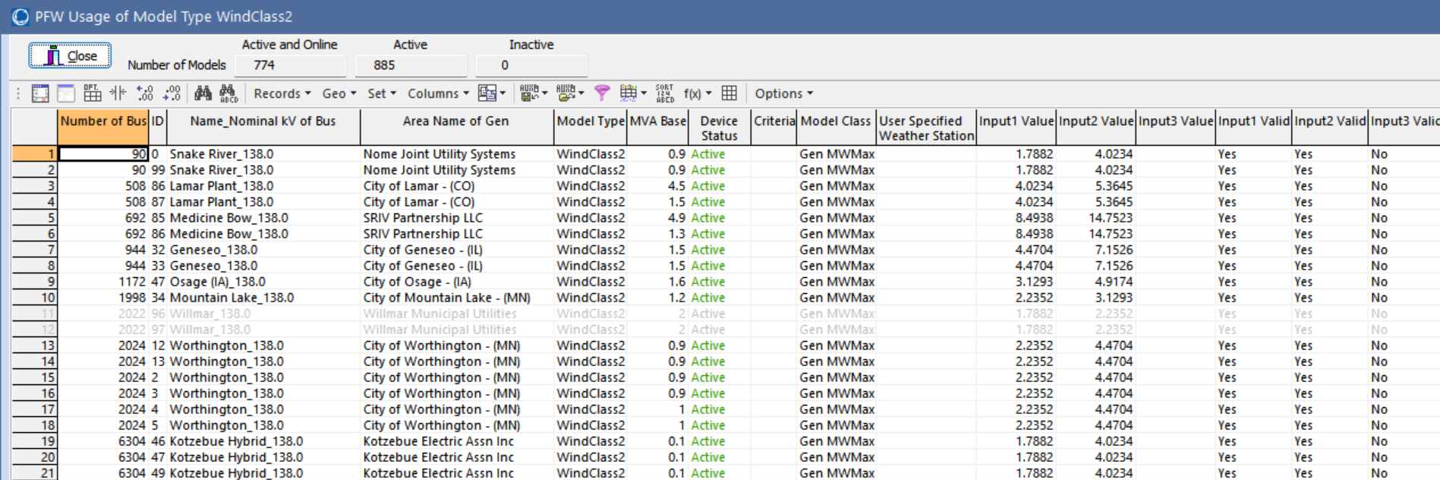
Example EIA-860 Wind Generator Data
Right image shows the PFW models to map weather (wind speed) to MW Max
From the Weather, Weather Models and Information display
Bottom image shows some EIA-860 wind generators with turbine information
For the CEII grids we have bus mapping for more than 95% of the generator capacity

Slide 52
Mapping Weather to the Electric Grid Components
While the newer weather datasets have lots of points, there is still usually at least some distance between power grid components and the nearest weather measurement, requiring interpolation
There is no single best algorithm for doing the needed 2D scattered data interpolation, but there are a number of good and fast algorithms (grid-based, closest neighbor, Delaunay Triangulation, Shepherd’s)
Since the weather values have an associated elevation, if the power grid component’s elevation (or profile for a line) is known this could be considered
Usually places in which the weather changes rapidly with geography (e.g., mountains) don’t have much electric infrastructure (the exceptions are covered next)

Slide 53
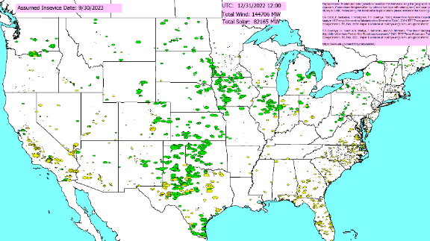
Applying the Weather
Weather can be applied to a power flow case using the pww files in multiple ways
At a specified point in time
As a summary of a large amount of weather at a single location (e.g., a generator) or at a few locations (a transmission line)
As a time series, sequentially solving lots of different time points
The next few slides demonstrate each of these, showing the change in the wind and solar outputs

Slide 54
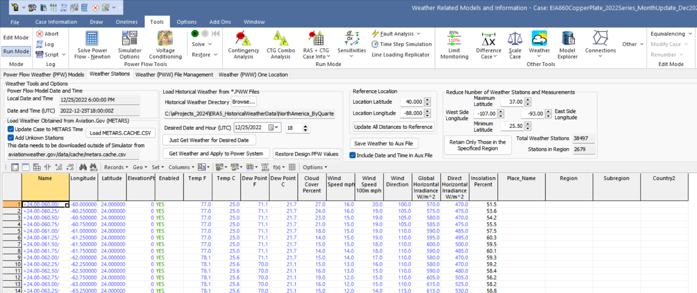
Applying Weather for a Single Time Point
With the provided pww files, any time going back to 1940 can be simulated. The pww files are designed for quick searching, and for providing direct access to all the data for a particular time.
Getting the access to the weather for all of North America takes about a second; optionally the weather can also be applied to the power flow
Once applied the power flow (and other applications) can be solved as normal
Restore values at the end

Slide 55
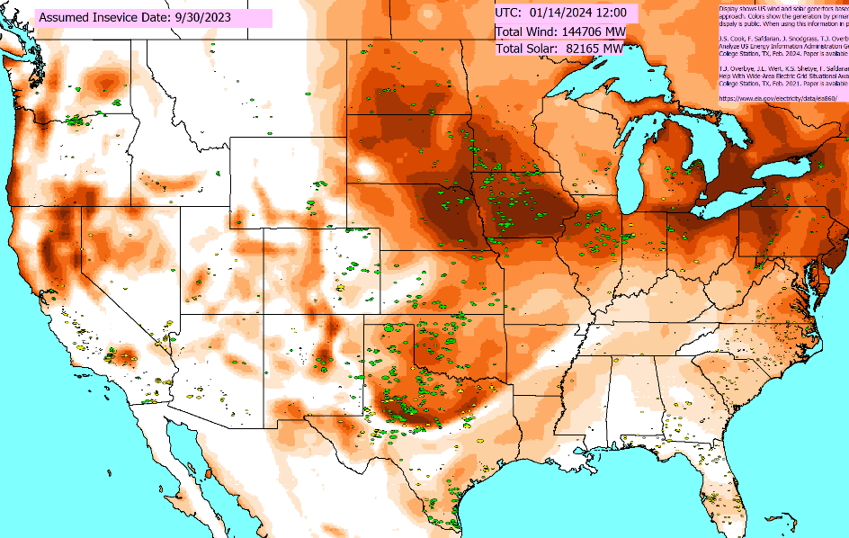

Applying Weather Without and With Updating the PFW Models and the Power Flow
Left image just shows the weather, without updating the PFW models (i.e., not changing the power flow values) whereas the right one also updates the PFW models (note the very low solar)

Slide 56


Contrasting Two Days: 4/29/2010 and 12/12/1941
Assuming the 12/31/2023 renewable generation (147 GW wind, 90 GW solar), we determined a few outlier days. At noon (Central) weather for 4/29/2010 would have an 73% available, while 12/12/1941 weather would have 15%
Applying the weather and getting the values is quick

Slide 57


December 12, 1941 Clouds and Wind
Dec 12, 1941 was a cloudy, mostly windless day nationwide. But this needs to be considered on a regional basis. For example, it would not have been a particularly severe day in Texas.

Slide 58
SRE Examples: Geomagnetic Disturbances (GMDs)
GMDs are caused by solar corona mass ejections (CMEs), and range from minor and frequent to severe and extremely rare
A GMD caused a blackout in 1989 of Quebec
They have the potential to severely disrupt the electric grid by causing quasi-dc geomagnetically induced currents (GICs) in the high voltage grid
Until recently power engineers had few tools to help them assess the impact of GMDs
GMD assessment tools are now moving into the realm of power system planning and operations engineers
57

Slide 59

GMD Overview
Solar corona mass ejections (CMEs) can cause changes in the earth’s magnetic field (i.e., dB/dt). These changes in turn produce a non-uniform electric field at the surface
Changes in the magnetic flux are usually expressed in nT/minute; from a 60 Hz perspective they are almost dc
1989 North America storm produced a change of 500 nT/minute, while a stronger storm, such as the ones in 1859 or 1921, could produce 2500 nT/minute variation
Storm “footprint” can be continental in scale
Image source: J. Kappenman, “A Perfect Storm of Planetary Proportions,” IEEE Spectrum, Feb 2012, page 29
58

Slide 60
Electric Fields and Geomagnetically Induced Currents (GICs)
The induced electric field at the surface is dependent on deep earth (hundreds of km) conductivity
Electric fields are vectors (magnitude and angle); values expressed in units of volts/mile (or volts/km);
A 2500 nT/minute storm could produce 5 to 10 volts/km
The electric fields cause GICs to flow in the high voltage transmission grid
The induced voltages that drive the GICs can be modeled as dc voltages in the transmission lines.
The magnitude of the dc voltage is determined by integrating the electric field variation over the line length
Both magnitude and direction of electric field is important
59

Slide 61

HILF Example: Nuclear EMPs
Broadly defined, an electromagnetic pulse (EMP) is any transient burst of electromagnetic energy
High altitude nuclear explosions can produce continental scale EMPs; called HEMPs
The impacts of an HEMP are typically divided into three time frames: E1, E2 and E3
E1 impacts electronics, E2 is similar to lightning, E3 is similar to a very large, but short duration GMD

Slide 62

Nuclear EMP History
The presence of EMPs was theorized by Enrico Fermi prior to the first explosion in July 1945
Many wires were shielded, but still some data was lost due to EMP
British called it “radioflash” in their tests in early 1950’s due to the presence of “clicks” heard on radios
Operation Hardtack tests in 1958 (up to 80 km in altitude) further demonstrated HEMP impacts
Trinity Explosion, July 16, 1945, 20 kilotons of TNT source: Los Alamos Lab

Slide 63

Nuclear EMP History: Starfish Prime
Starfish Prime was an explosion of a 1.44 megaton nuclear weapon at an altitude of 400 km over the Pacific Ocean in July 1962
Part of series of tests known as Operation Fishbowl
The EMPs were much larger than expected, driving instruments off scale
Impacts seen in Honolulu (1445 km away), including knocking out about 300 street lights, setting off alarms, and damaging a microwave link
Some low earth orbit satellites were also damaged
Starfish Prime observed on Maui in 1962, Source US EMP Commission Report from July 2017

Slide 64

Geomagnetically Induced Currents (GICs)
Both GMDs and HEMPs cause electric fields, with values dependent on the deep earth conductivity
Along length of a high voltage transmission line, electric fields can be modeled as a dc voltage source superimposed on the lines
These voltage sources produce quasi-dc geomagnetically induced currents (GICs) that are superimposed on the ac (60 Hz) flows
63

Slide 65
Simulated GICs in High Voltage Transmission Grid

Slide 66

Overview of GMD Assessments
In is a quite interdisciplinary problem
The two key concerns from a big storm are 1) large-scale blackout due to voltage collapse, 2) permanent transformer damage due to
overheating; similar concerns due to HEMPs
Image Source: http://www.nerc.com/pa/Stand/WebinarLibrary/GMD_standards_update_june26_ec.pdf
65

Slide 67

The Impact of a Large GMD From an Operations Perspective
Would be maybe a day warning but without specifics
Satellite at Lagrange point one million miles from earth would give more details, but with less than 30 minutes lead time
Could strike quickly; rise time of minutes, rapidly covering a good chunk of the continent
Reactive power loadings on hundreds of high voltage transformers could rapidly rise
Increased transformer reactive loading causes heating issues and potential large-scale voltage collapses
Control room personnel would be overwhelmed
The storm could last for days with varying intensity
66

Slide 68

GIC Mitigation
Tools are needed to determine mitigation strategies
Cost-benefit analysis
GIC flows can be reduced both through operational strategies such as opening lines, and through longer term approaches such as installing blocking devices
Redispatching the system can change transformer loadings, providing margins for GICs
Algorithms are needed to provide real-time situational awareness for use during GMDs
67

Slide 69

Strategies to Prepare For and Mitigate Large- Area, Long-Duration Blackouts
While events may vary, there a number of broad approaches that can be used to help improve resilience
Image Source: Figure 4.1, NAS, 2017

Slide 70
Component Hardening, Physical Security
Electric grids are comprised of components, and resiliency can be enhanced by hardening particularly vulnerable components
Transmission lines in likely icing location, undergrounding some lines, transformers with better handling of geomagnetically induced currents (GICs), water protection
This needs to be done considering the cost versus benefit
Vegetation management should also be considered
Physical security is an area of increased concern, with unmanned aerial vehicles being a fast rising threat

Slide 71
Distribution System Automation
Distribution systems have traditionally been radial, with little ability for dynamic reconfiguration
This is rapidly changing, with growing use of distribution automation
A finding of the NAS 2017 was, “While many distribution automation technologies are available that would enhance system resilience, their cost of deployment remains a barrier, particularly in light of challenges in monetizing the benefits of such installations.”

Slide 72
Distributed Energy Resources (DERs)
DERs are devices in the distribution system that can provide power
This could be isolated backup power, power only when grid connected, or the ability to function as an autonomous microgrid
DERs can be used to delay or eliminate additions to the bulk grid
The value of DERs is enhanced if 1) there is some potential for grid control, and 2) they have the ability to operate isolated from the grid [such as solar PV with battery storage]
Fault ride through capability is of growing importance

Slide 73
Enhancing Bulk Grid Simulations to Handle HILF Scenarios
The stressed operation associated with the high impact, low frequency events presents modeling challenges
Luckily, over the last several years the software is being enhanced to deal with these situations
My next presentation goes in-depth on geomagnetic disturbance (GMD) and high altitude electromagnetic pulse (HEMP) modeling
There is also a need to consider high voltage transmission system design that lessens the likelihood of cascading outages

Slide 74
Adaptive Islanding
One promising resiliency technique is to design interconnected grids to split (island)
This is known as controlled islanding and can be enhanced to be adaptive islanding
A distribution system example is a microgrid
The islands need to be chosen so they have sufficient generation to match load
Often control is still centralized
A more involved islanding issue is to setup the grid so smaller parts can function with full autonomy

Slide 75
Resiliency and Coupled Infrastructures
As our societies become more dependent on electricity, short and small duration blackouts become more concerning, and large-scale, long duration outages can be catastrophic
There are many couplings between electric grids and other infrastructures such as natural gas, water, cyber, and increasing transportation
These couples need to be more fully considered in electric grid resiliency modeling and simulation

Slide 76
Some Specific Recommendations to Enhance Resilience
A “visioning” process is needed to imaging and assessing plausible high impact events
The electric grid operators need to do exercises to better simulate high impact scenarios
More physical components are needed, including replacement transformers and backup power
More research, development and demonstration is needed, including a focus on cyber and HILFs
Resilience groups are needed throughout the industry and government to raise awareness
Source: National Academies 2017 “Enhancing the Resilience of the Nation’s Electricity System”
75

Slide 77
Conclusion and Questions?
The electric grid is crucial to societies worldwide, and for decades into the future we will be relying on it
A perfect electric grid is impossible, and we need to be prepared for long-term, wide-area blackouts
However, much can and should be done to reduce to reduce this risk
A broad, sustained effort is needed in this area including the entire electric grid sector
Synthetic electric grids will play a crucial role in this effort
76

Slide 78

Thank You! Questions?

